Slide 1

SMART RADAR SYSTEM
Using IoT

Slide 2
Supervised by : A. Prof. Ahmad Magdy

Slide 3
Using IoTpre
prepared by :
Ahmed sameh Omar morssy
Motaz Tarek Sayed Sukar
Amira Shaaban Ahmed Alaa

Slide 4
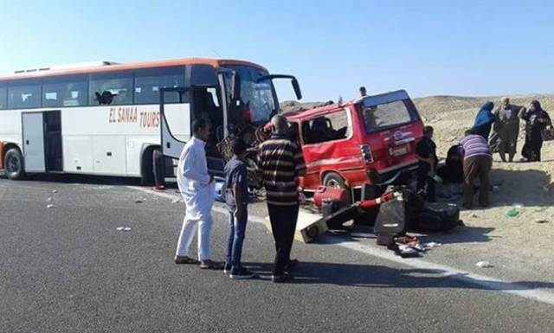
Motivation and objective
According to WHO
(WorldHealthOrganization),
Egypt loses about 12 000 lives due to road traffic crashes every year. It has a road traffic fatality rate of 42 deaths per 100,000 population.
Our objective is to limit traffic crashes that result from driving with high speed.

Slide 5
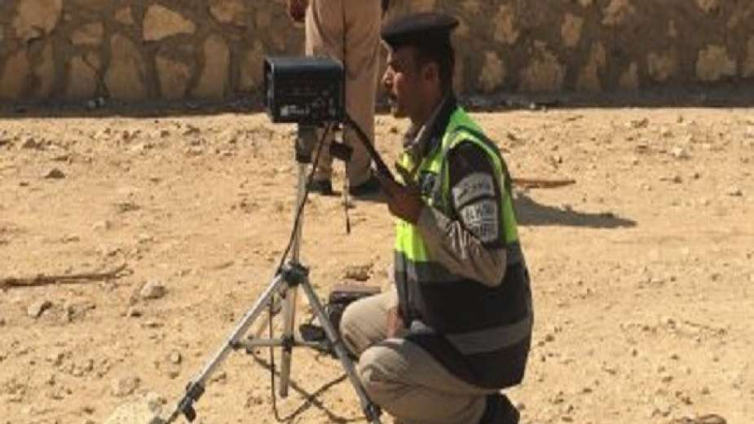
Main problem
People manage to work their way around the current RADAR system.
The current RADAR has short range
(1000 ft) (304.8 m).
Not all roads are covered by the current RADAR system.

Slide 6

Solution
Implementing IOT in a new RADAR system that is more effective.
New RADAR system covers more distance.
IOT device planted in each car to track it in roads which are not covered by RADAR.

Slide 7
Tools used
OpenCV
Python 3.7
Firebase google cloud,
unwired labs Location API for location acquiring
openStreetMap® for the maps implementation

Slide 8
Introduction
1

Slide 9
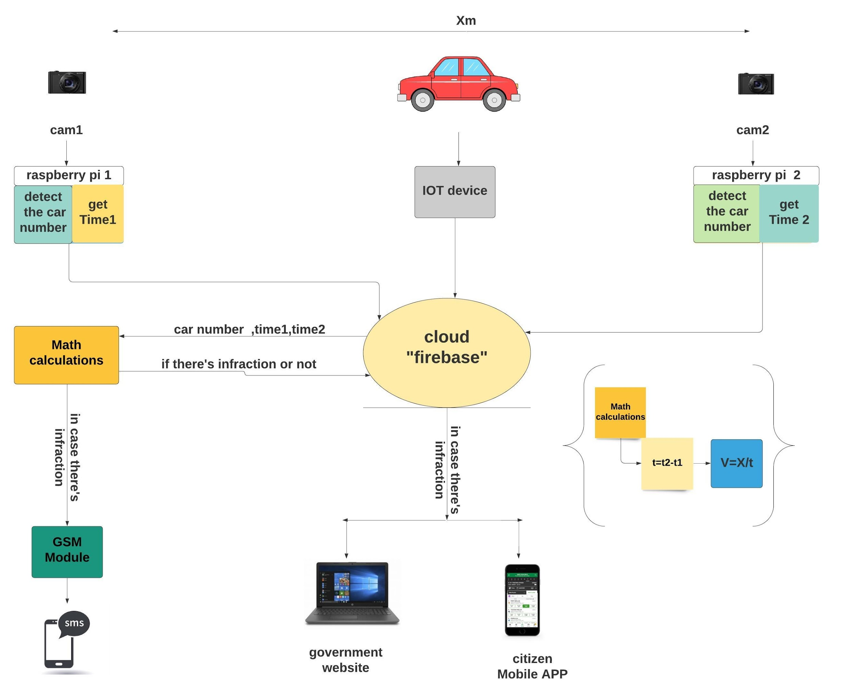
System block diagram

Slide 10
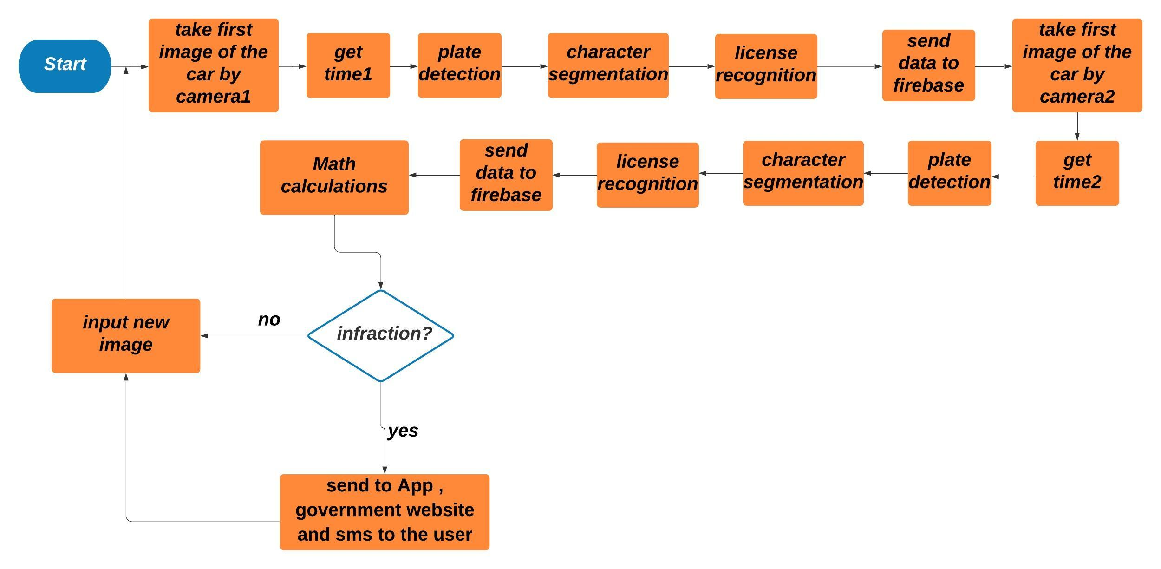
project flow chart

Slide 11
IOT SYSTEM IMPLEMENTATION
2
A brief explanation…

Slide 12
IoT
What is IoT?
Main Components
Popular Applications
Internet of Things

Slide 13


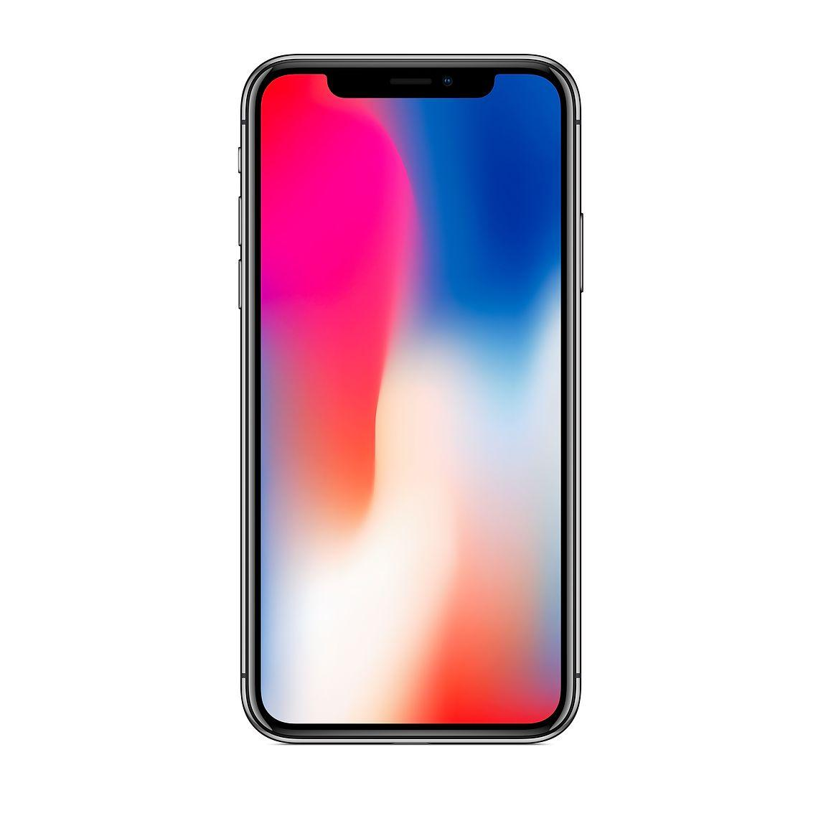

Read and Write
Read and Write
Read Only
Microcontroller
Mobile Application
Website

Slide 14
SMART RADAR SYSTEM
3
The Actual System explained

Slide 15
Embedded System
-What is embedded system ?
-Examples in our life
-Implementations

Slide 16
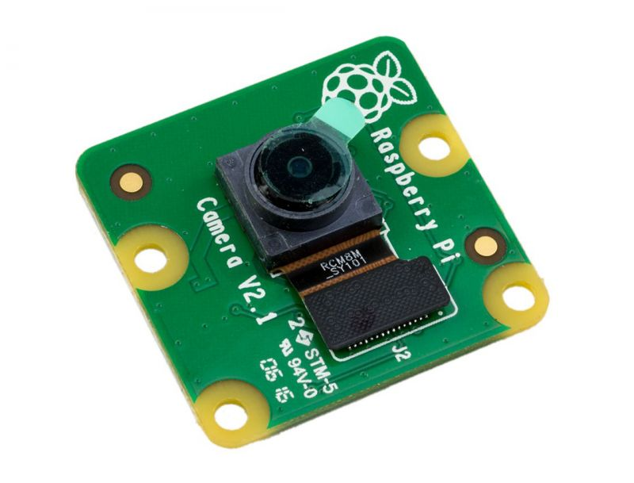
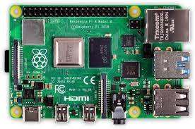
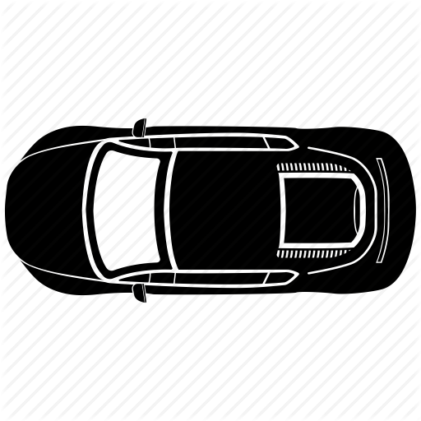
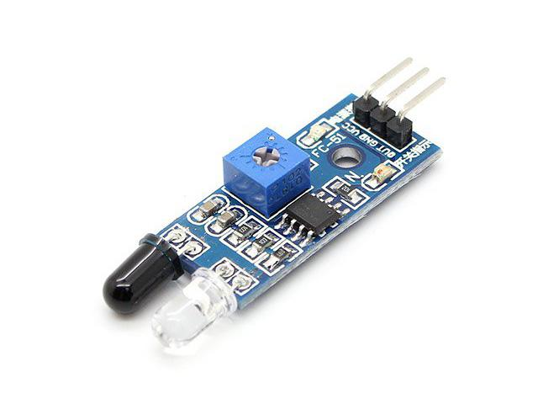
The Embedded system

Slide 17
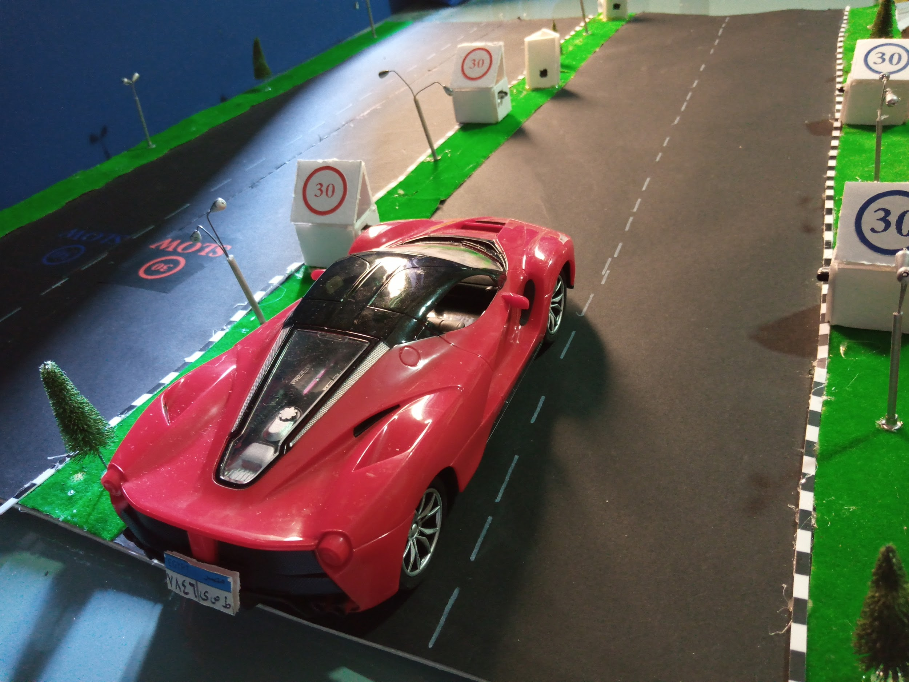
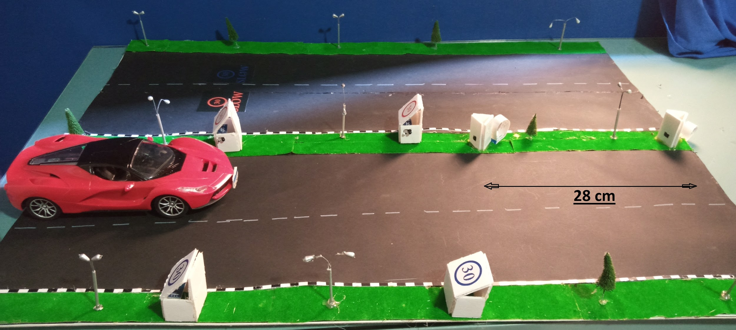
Maquette simulation

Slide 18
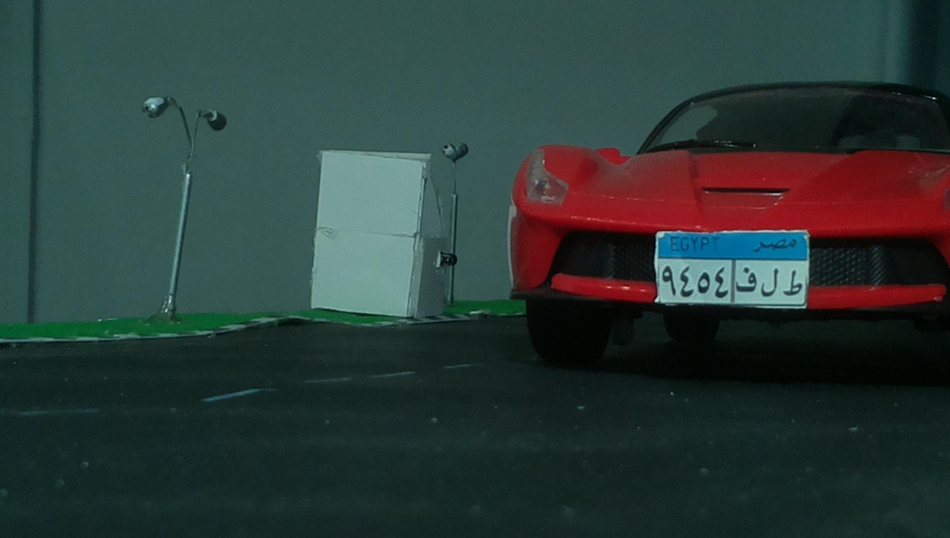

Slide 19
PLATE DETECTION
3

Slide 20
Plate Detection
We use pure image processing in the operation of finding a plate within a certain photo.
Notes:
6/25/2020
‹#›
‹#›

Slide 21


Image Processing
Image processing is a method to perform some operations on an image, in order to get an enhanced image or to extract some useful information from it. It is a type of signal processing in which input is an image and output may be image or characteristics/features associated with that image.

Slide 22
Steps
Pre-processing
Thresholding
Drawing all contours
Finding potential characters
Finding Possible Plates
Finding final plate
Notes:
6/25/2020
‹#›
‹#›

Slide 23
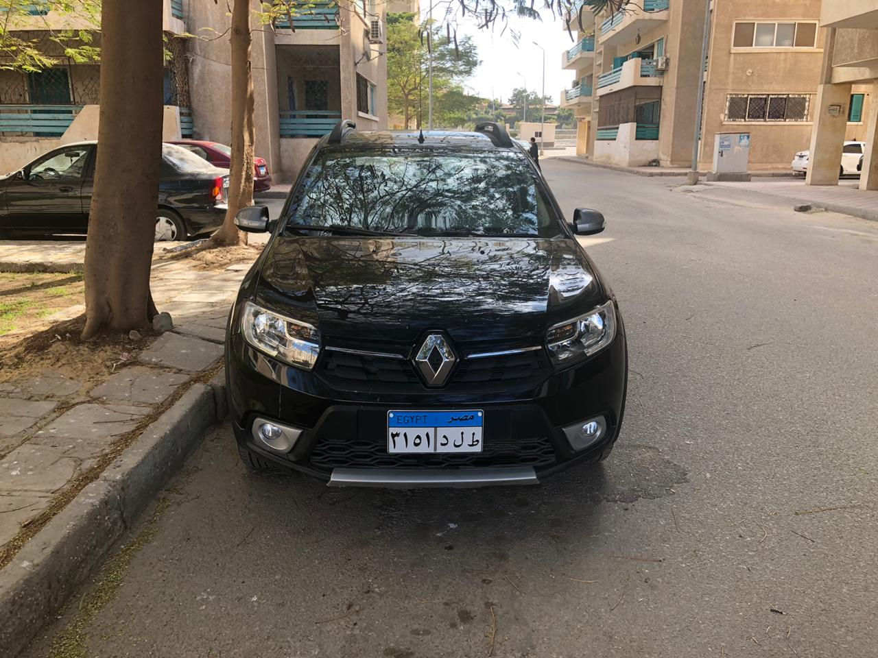
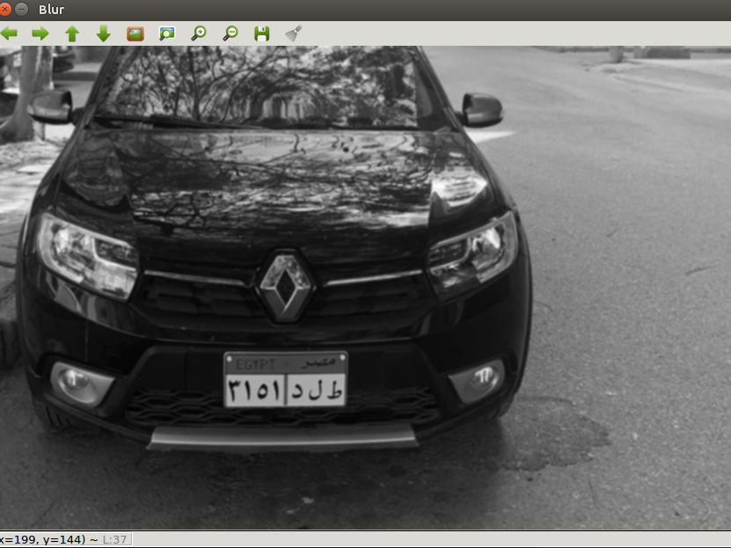
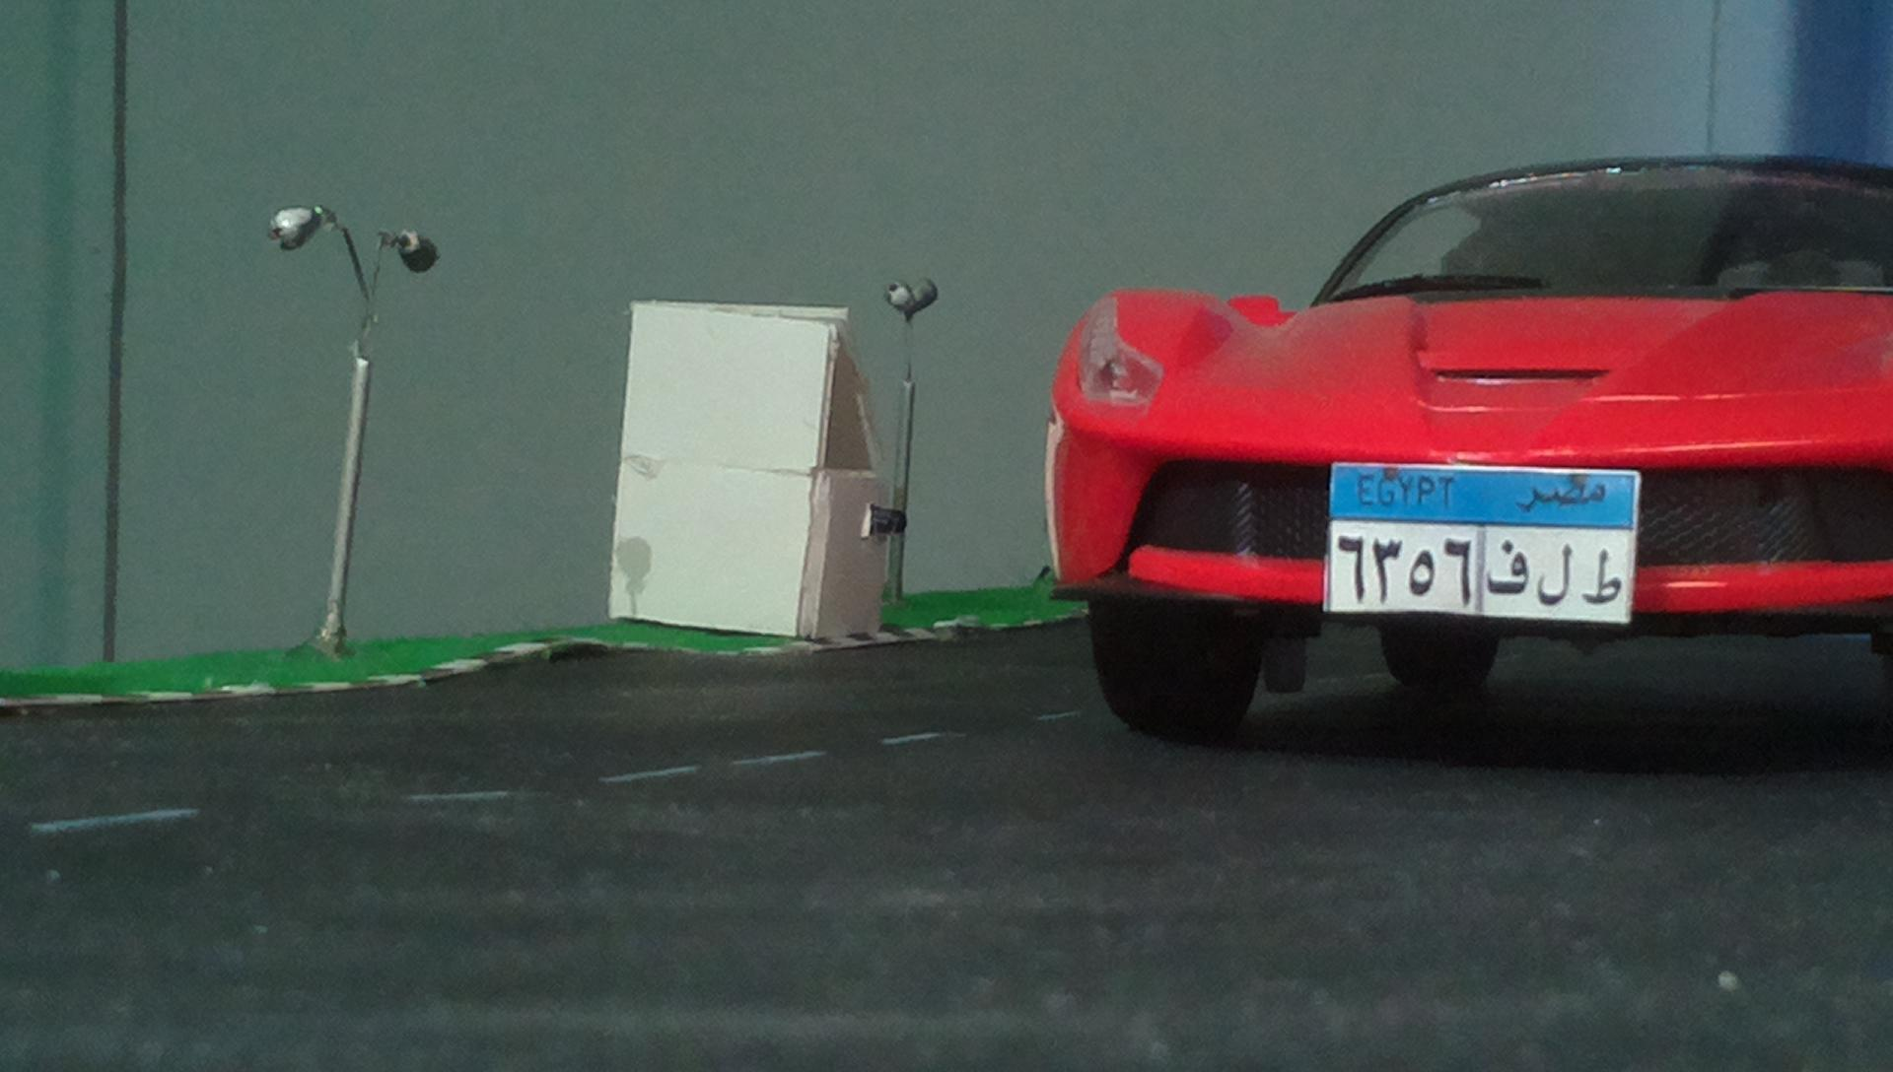
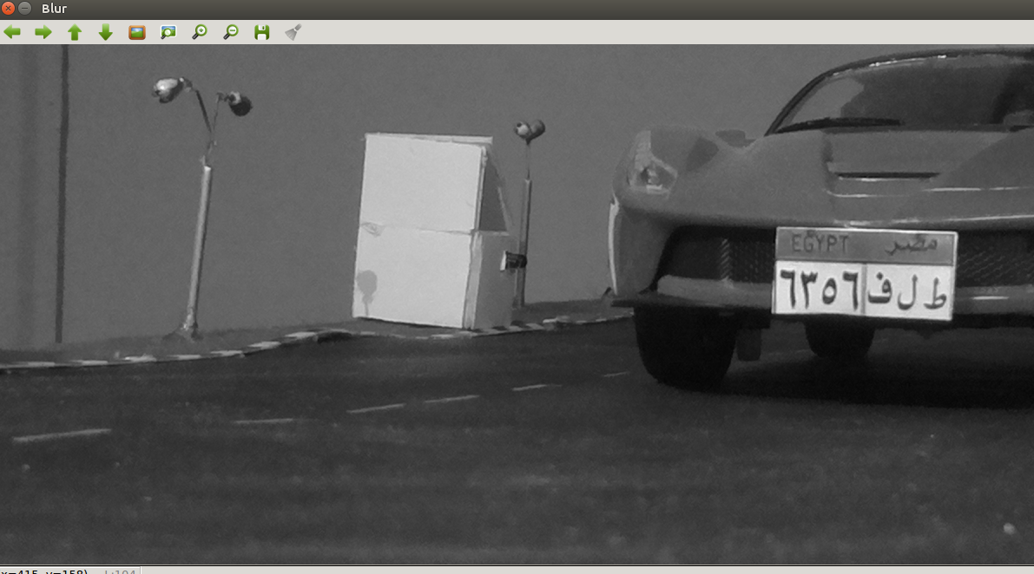
First: Pre-Processing
Cropping
Resizing
GrayScale
Gaussian Blur
Notes:
6/25/2020
‹#›
‹#›

Slide 24
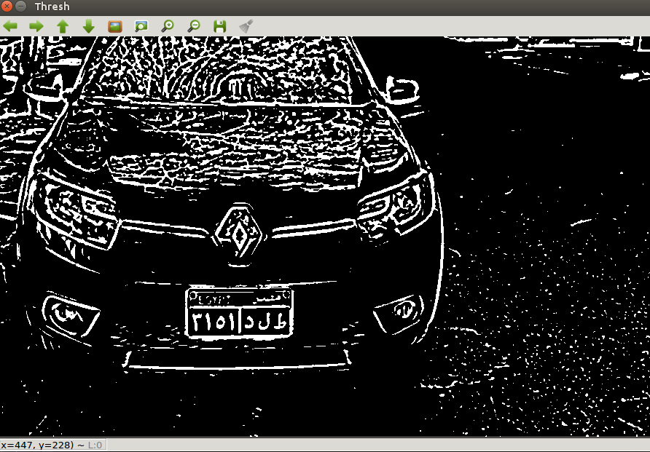
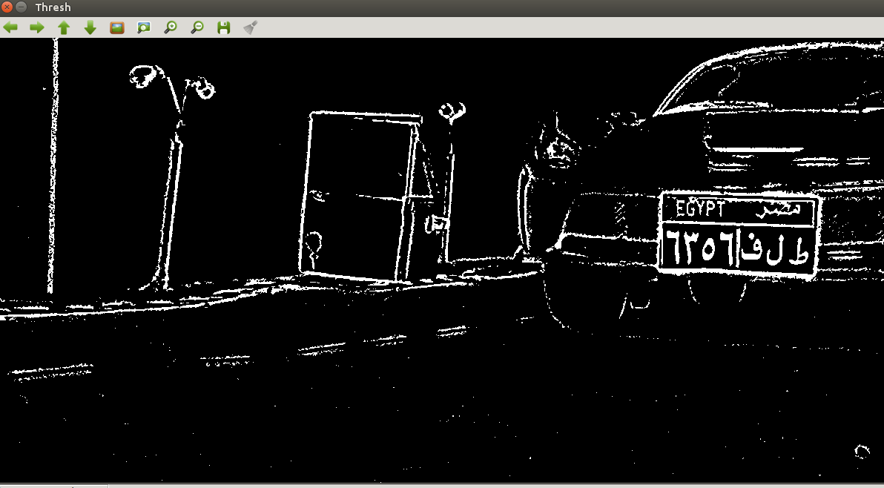
Second: Thresholding
It is basically rounding each value of each pixel to one of two values , either 0 or max value which is mostly 255.
The threshold which we compare the value to is set by us , if the value of the pixel is lower than the threshold value then it is rounded to zero , if not then it is rounded to max value (255).
Notes:
6/25/2020
‹#›
‹#›

Slide 25
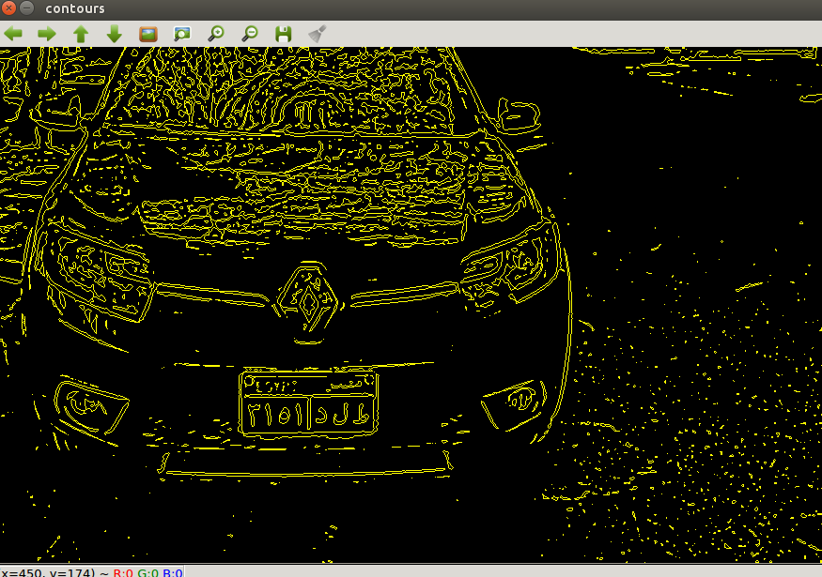
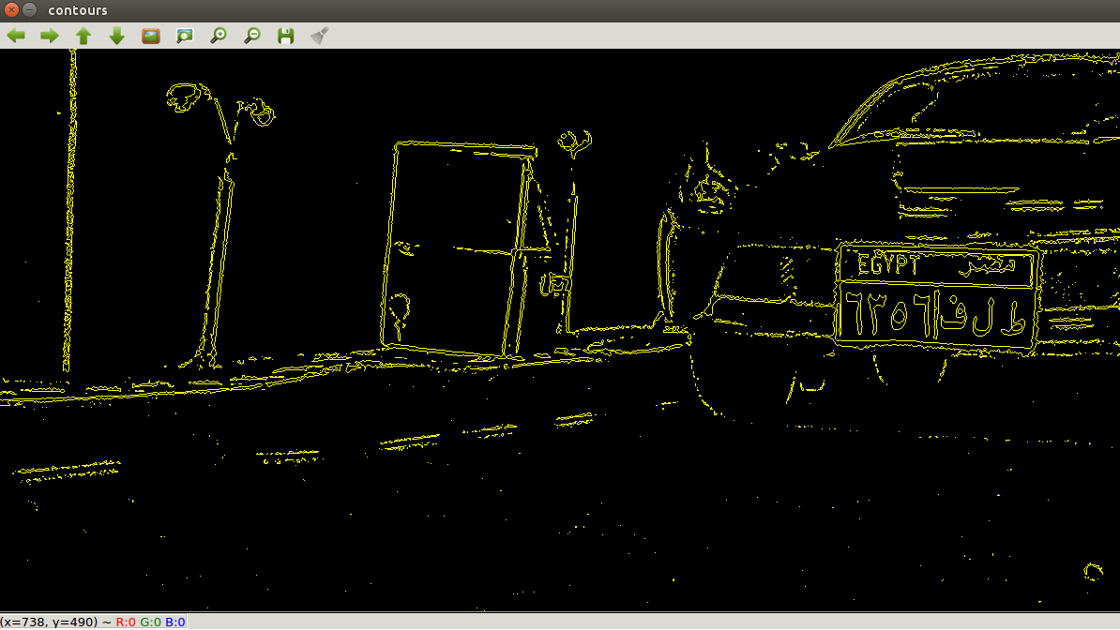
Contours can be explained simply as a curve joining all the continuous points (along the boundary), having same color or intensity. The contours are a useful tool for shape analysis and object detection and recognition.
Third: Drawing all contours
Notes:
6/25/2020
‹#›
‹#›

Slide 26
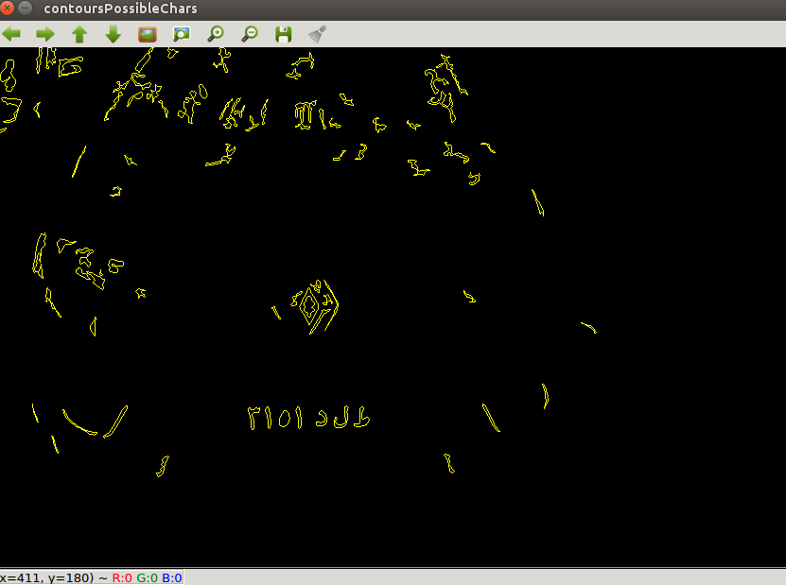
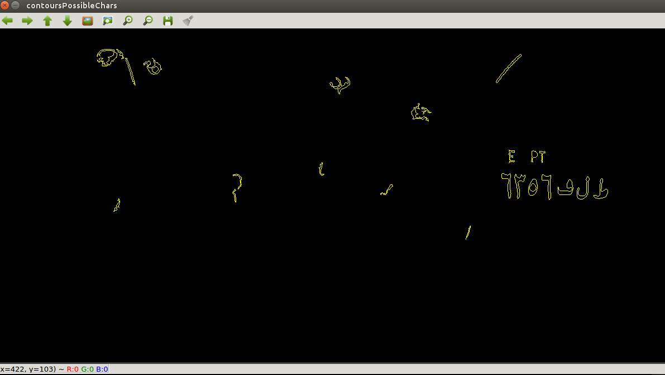
Fourth: finding potential characters
In order to distinguish contours that may resemble a character from other contours we use two parameters , these parameters are Area of the rectangle surrounding the contour (Are of bounding rect) and the aspect ratio of the bounding rectangle (width/height).
Notes:
6/25/2020
‹#›
‹#›

Slide 27
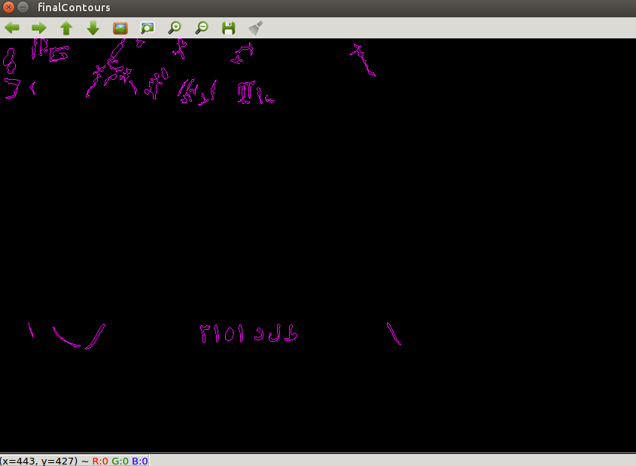
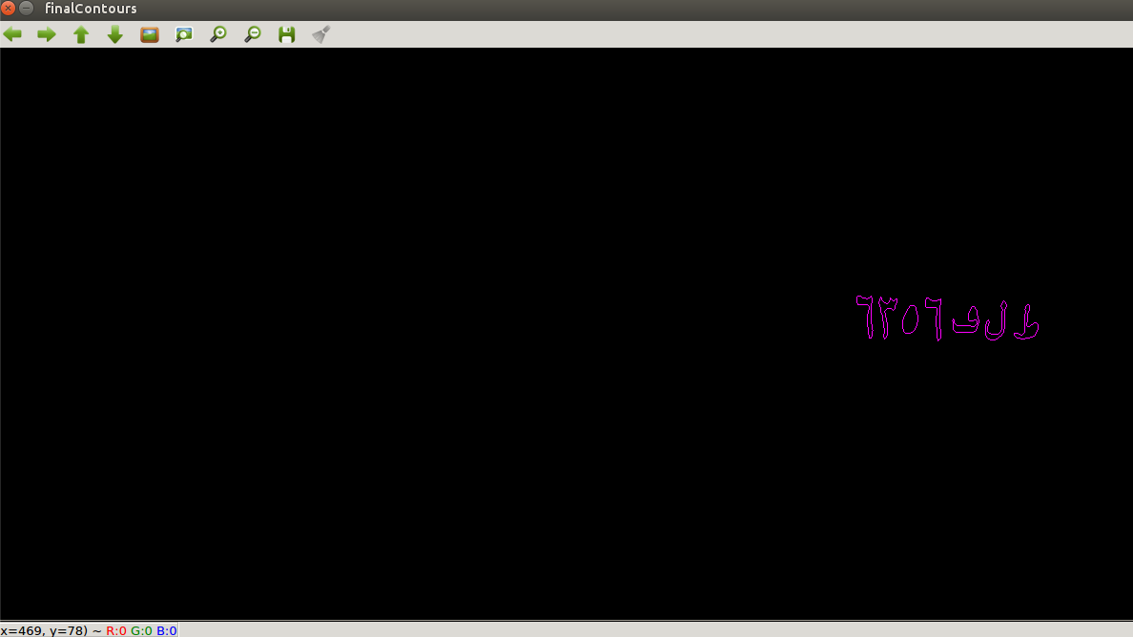
Fifth: Finding possible plates
We take each character found using the previous step then we do some comparisons with each other character and if this character is similar to another 5 or 6 characters then this should be a Possible Plate.
Notes:
6/25/2020
‹#›
‹#›

Slide 28
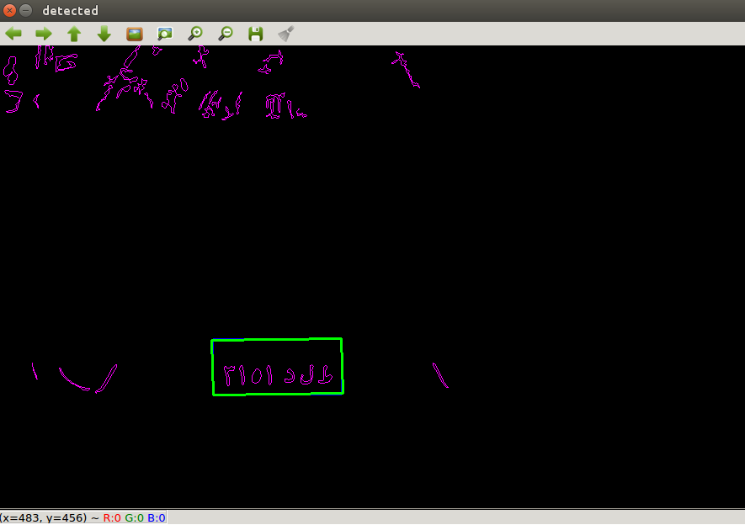
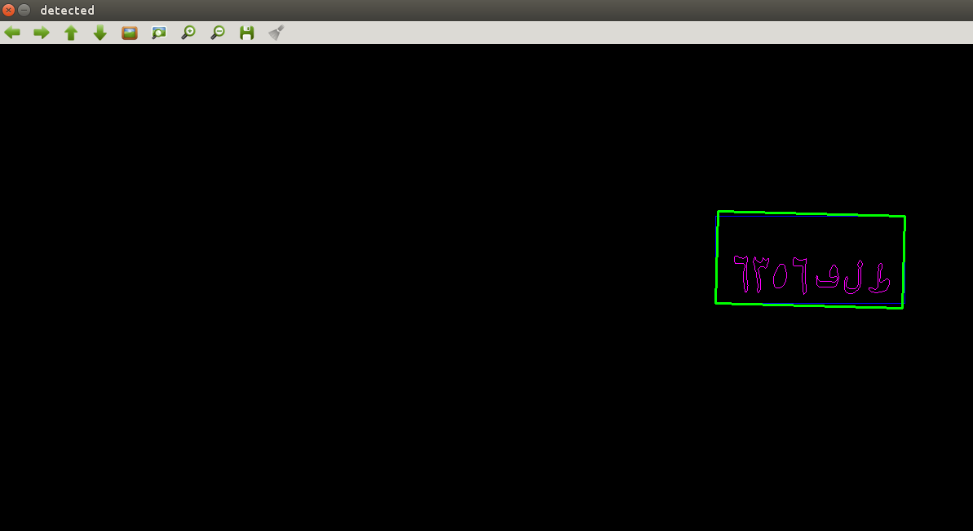
Sixth: Finding the Plate
After getting the list of possible plates using the previous method, we use one last filter which is the aspect ratio of the plates.
The aspect ratio of an arabic lisence plate should be 2.0588 but in our case we leave error margain.

Slide 29
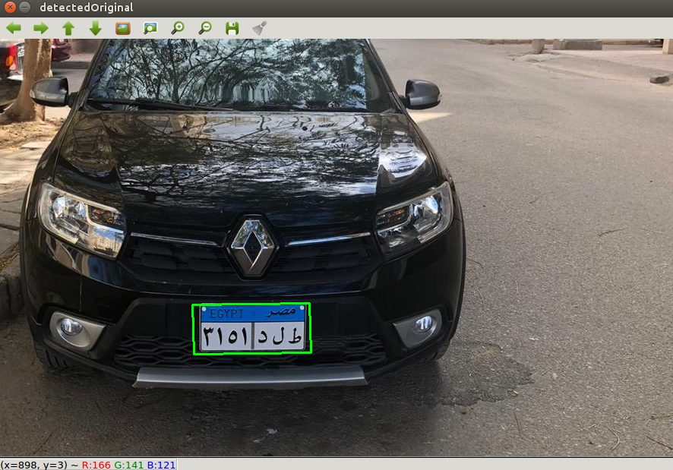
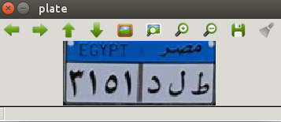
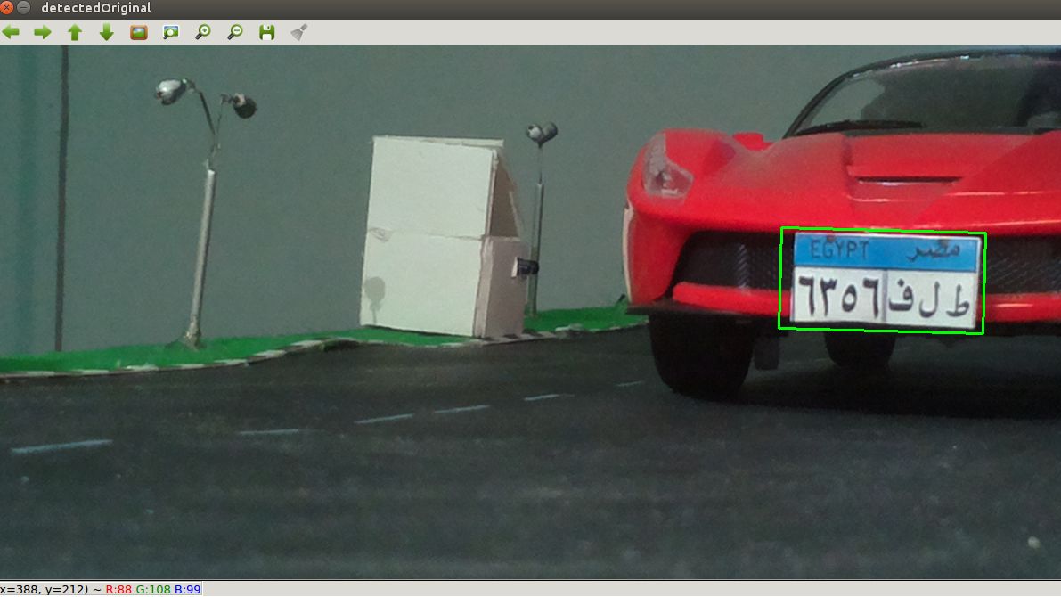
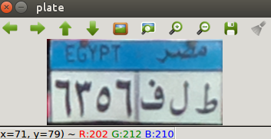
Finally
Notes:
6/25/2020
‹#›
‹#›

Slide 30
CHARACTER RECOGNITION
4
SMART RADAR

Slide 31
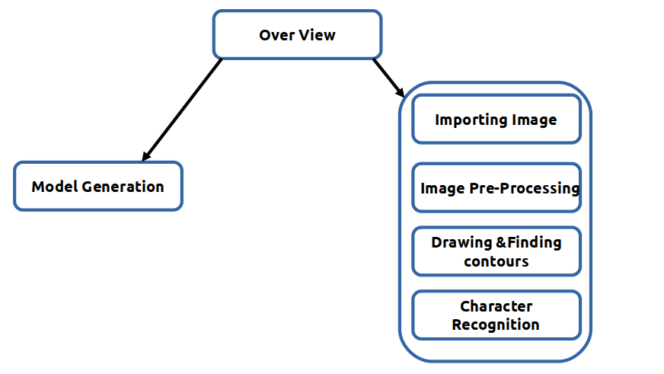
Introduction

Slide 32
Imported Libraries
Open cv
OS
Arabic Reshaper
Numpy

Slide 33

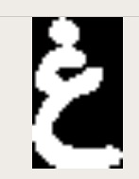

Model Generation
To create a training model we use certain data set using certain python code and generate two model files
("classifications.txt","flattened_images.txt"
Gray scale
Gaussian Blurring filter
Adaptive thresholding
Morphological Operation
Drawing & Finding Contours
KNN

Slide 34
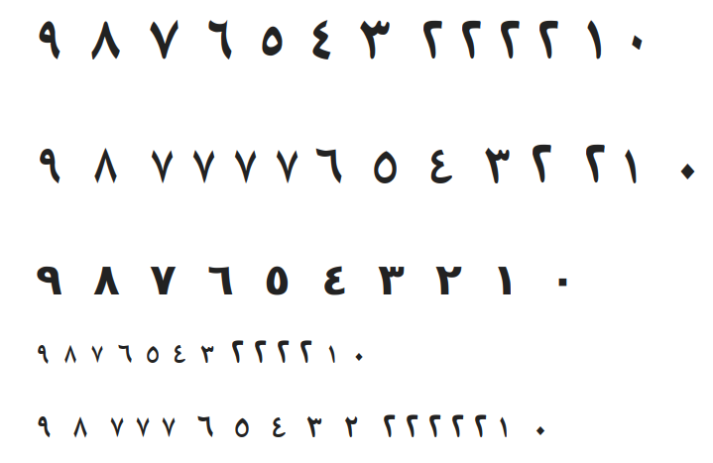
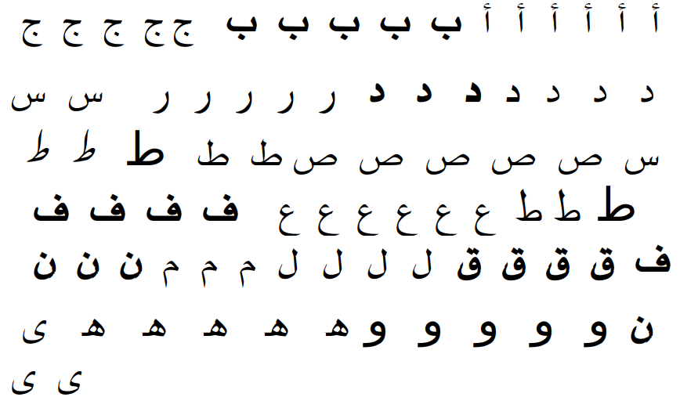
Data Set

Slide 35
Code Sequence
Main
Plate detection
Resizing
Cropping
Recognition
base

Slide 36
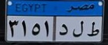
Plate Detection
Input
Output
This is the function used to call the code to be executed to extract the licence plate from the whole imported image and return the output to the next process

Slide 37
Resizing
The function that take a parameter the plate image returned from PlateDetection.main() and resize it to a certain level using openCV (CV2) library for the next operations or processing
“cv2.resize(src, dsize[, dst[, fx[, fy[, interpolation]]]])”

Slide 38
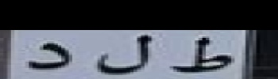
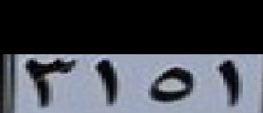
Cropping
image[start_x:end_x, start_y:end_y]
OUTPUT

Slide 39
Recognition
Training and recognition:
To recognize the characters ,firstly we train the model files resulted from the Model generation and then using the training result to recognize the character plate using this sequence
retval, npaResults, neigh_resp, dists = kNearest.findNearest(npaROIResized, k = 1)
Gray scale
Gaussian Blurring filter
Adaptive thresholding
Morphological Operation
Drawing & Finding Contours
KNN
Arabic Reshaper

Slide 40
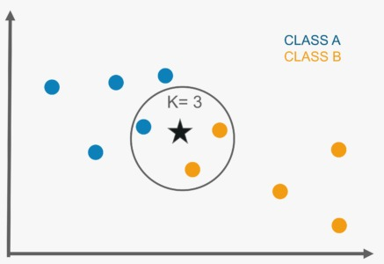
Recognition
KNN

Slide 41
Output

Slide 42
Read and Write
Read and Write
Read Only
Microcontroller
Mobile Application
Website

Slide 43
Firebase
What is Firebase?
Main Features
Firebase vs MySQL
Google’s famous mobile and web application development platform

Slide 44
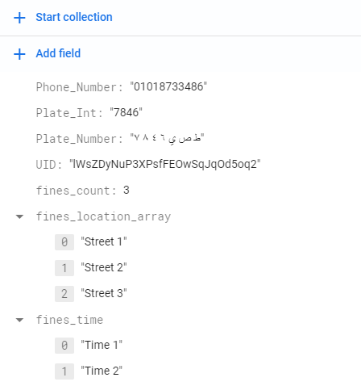
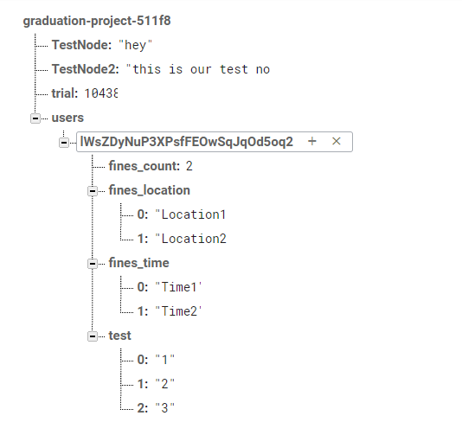
Firebase Implementation

Slide 45
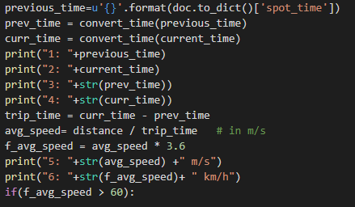

Slide 46
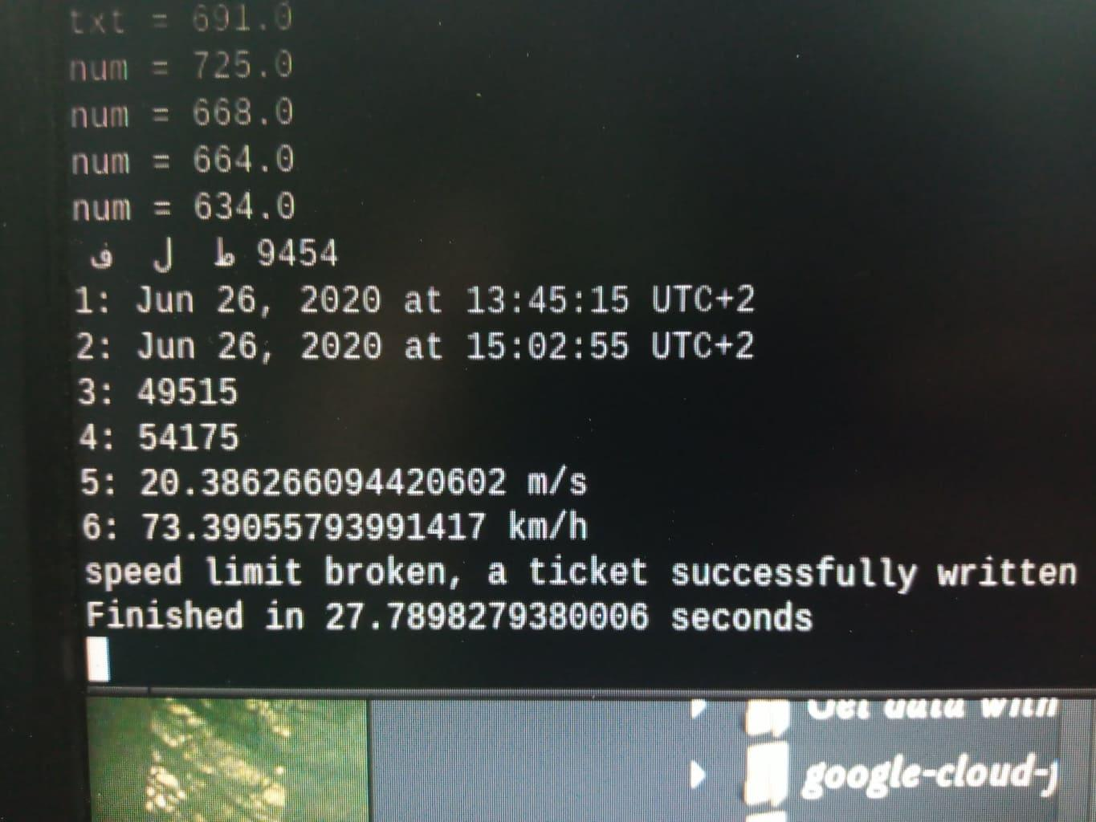
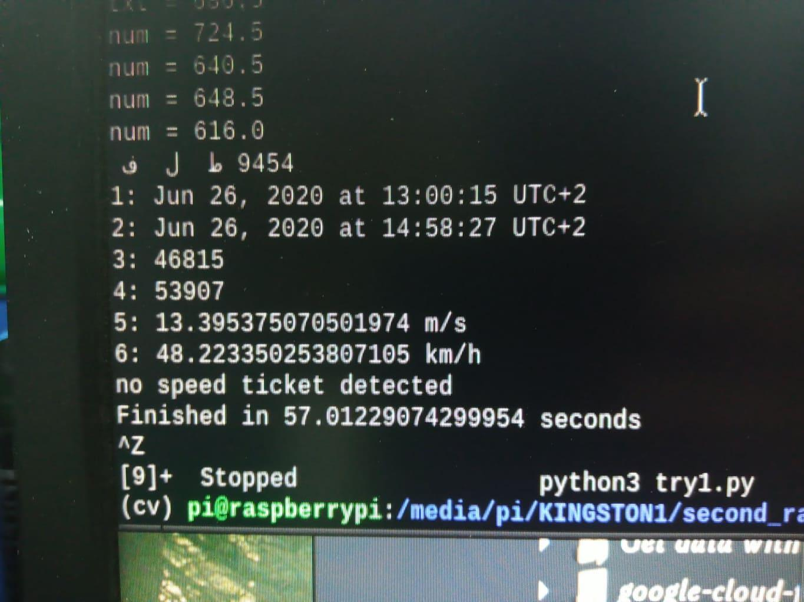

Slide 47
IoT device
Why?
Main components
resluts
(Internet of Things)

Slide 48
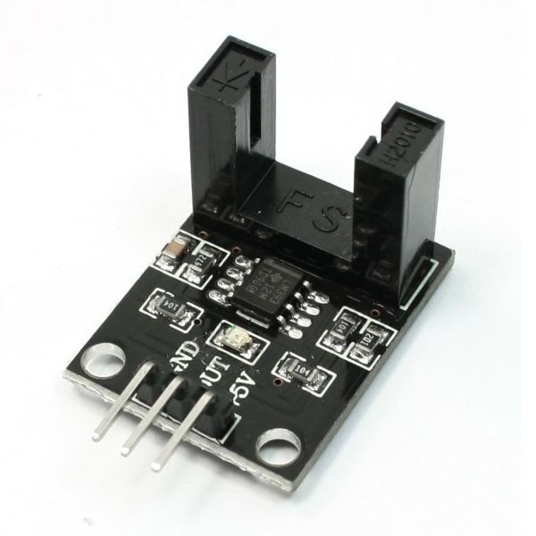
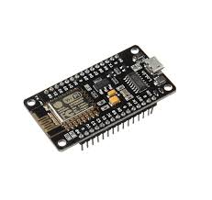
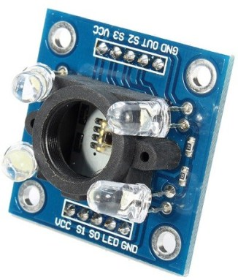
Iot device implementation
NodeMCU 8266
color sensor
LM393

Slide 49
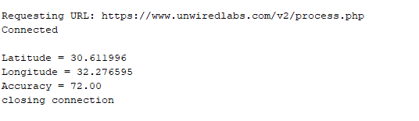
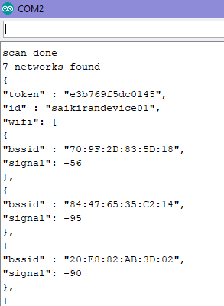
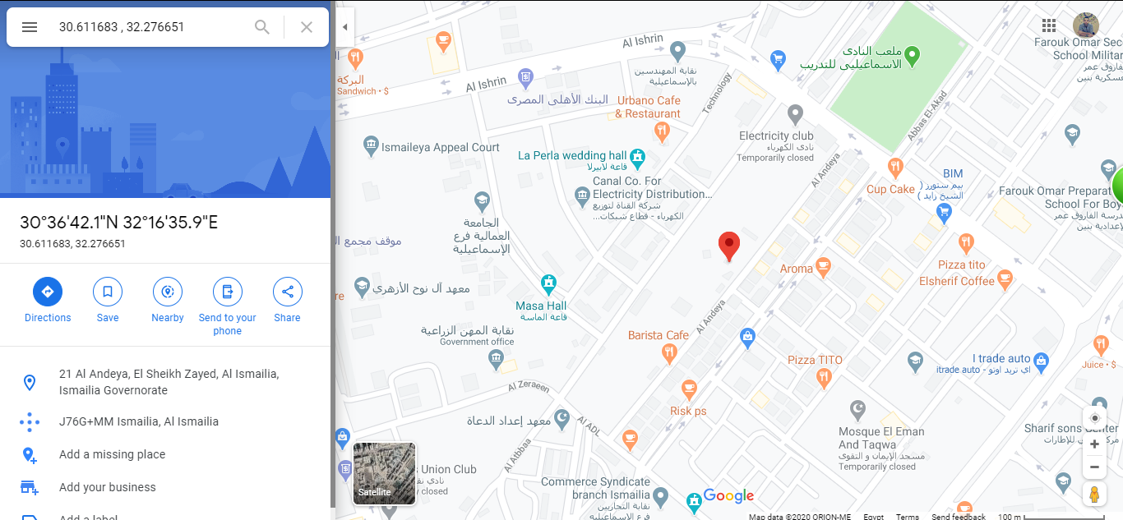
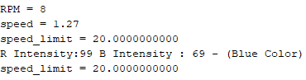
Iot Device results
40

Slide 50

Comparing results

Slide 51
Color Sensor
What is color sensor?
Why we use color sensor in our project?

Slide 52

TCS3200 color sensor
How does the TCS3200 sensor work?

Slide 53



Data flow
Pin out

Slide 54


Connection

Slide 55
LM393
speed motor sensor
What is speed motor sensor ?
Why we use speed motor sensor in our project?

Slide 56
its equations
RPM = (Pulse Frequency in pulses/sec)×(60 sec/min)/(Sensor pulses/revolution) = Revolutions/Minute
Frequency = 1/Period
RPM = 60/Pulse period x PPR

Slide 57


connection

Slide 58
GSM
5

Slide 59
GSM
Why we use GSM in our project
We use here mini GSM/GPRS + GPS breakout - SIM808
Its features

Slide 60

What is the SIM808 Module?

Slide 61


Connection

Slide 62
User end side
Mobile Application
Website

Slide 63
Mobile Application
Swift vs Obj-C
Design pattern used (MVC and Singleton)
Application Flow

Slide 64




Slide 65




Slide 66
Website
Backend (Firebase)
Firebase Hosting
Javascript (linker)
Frontend

Slide 67
Applications
7

Slide 68
law Enforcement
It is able to automatically identify stolen cars based on the up-to date blacklist. Other very common law enforcement applications are red-light enforcement and overspeed charging and bus lane control

Slide 69
Parking
Parking One of the main applications of ANPR is parking automation and parking security: ticketless parking fee management, parking access automation and vehicle location guidance

Slide 70
Journey time measurment
Journey Time Measurement is a very efficient and widely usable method of understanding traffic, detecting conspicuous situations and events, etc.

Slide 71
Future Work
8

Slide 72
Machine learning
What is ML?
How will we use it in our project ?

